Slide 1
Week 1
Number and Algebra
AQA Further Maths GCSE

Slide 2
Objectives
To understand the product rule for counting
To be able to work with and simplify surds
To be able to use basic algebra to solve problems

Slide 3
Notes
To understand the product rule for counting

Slide 4
Notes
To be able to work with and simplify surds

Slide 5
Notes
To be able to use basic algebra to solve problems

Slide 6
Example 1
Monty is in the business of arranging fruits in a straight line. If they have a dragon fruit, a guava, a lychee and a pineapple, how many different arrangements of the fruit are there?

Slide 7
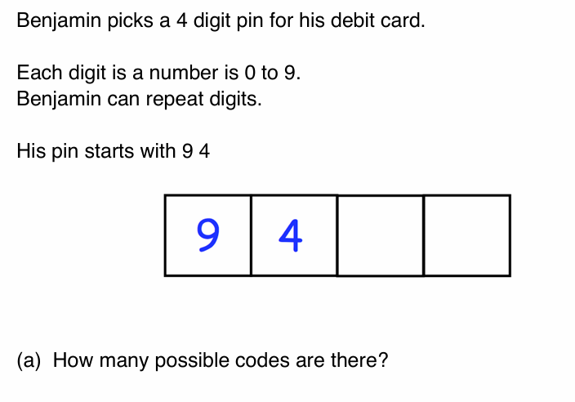
Example 2

Slide 8
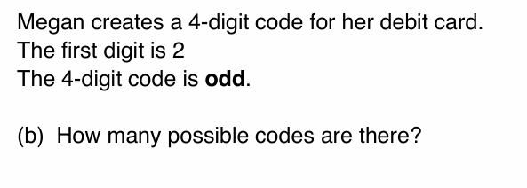
Example 2 continued

Slide 9
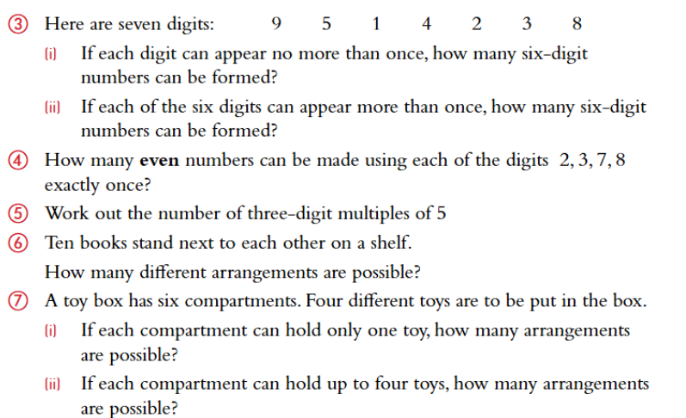
Exercises

Slide 10
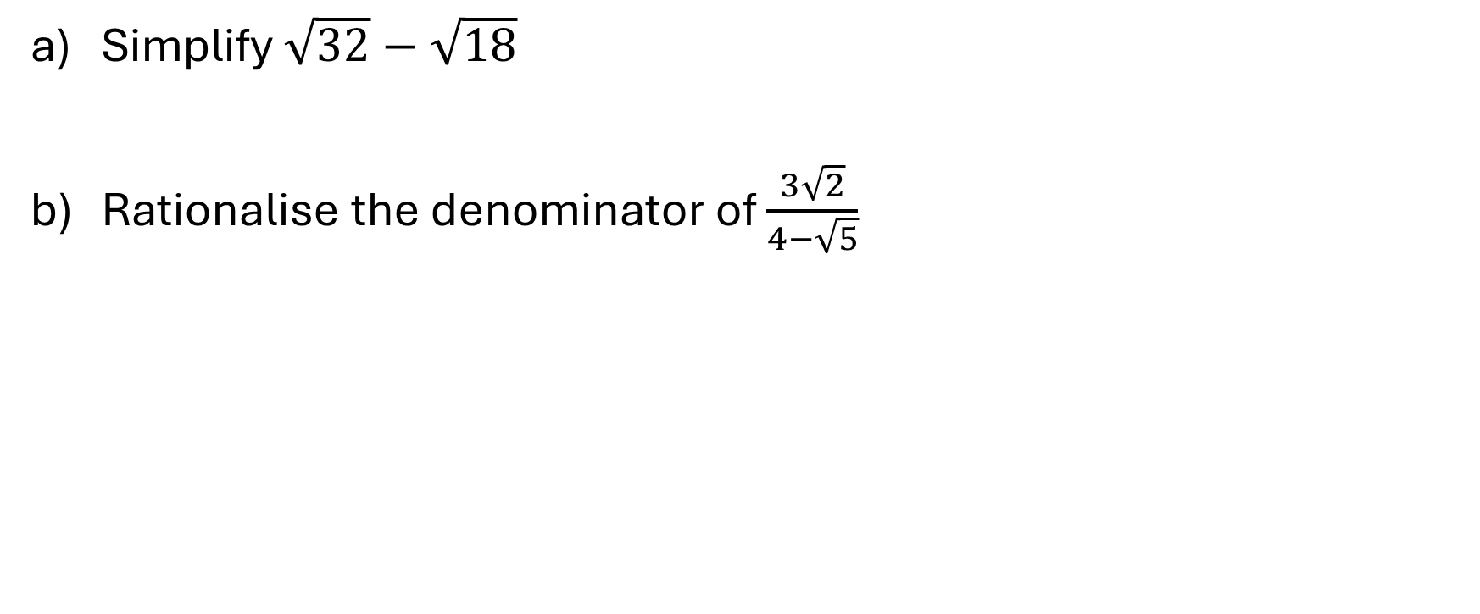
Example 3
Simplify $\sqrt{32}−\sqrt{18}$
Rationalise the denominator of $\frac{3\sqrt{2}}{4−\sqrt{5}}$

Slide 11
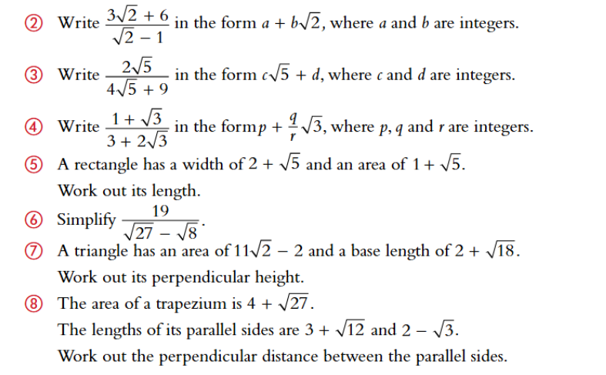
Exercises

Slide 12

Example 4

Slide 13
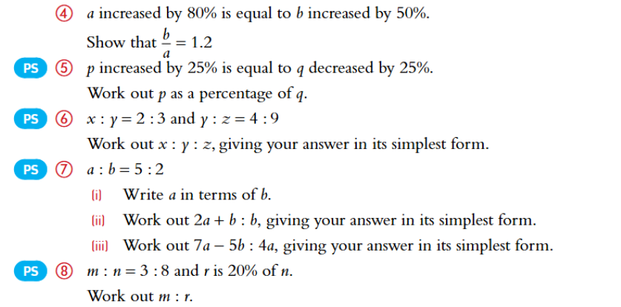
Exercises

Slide 14
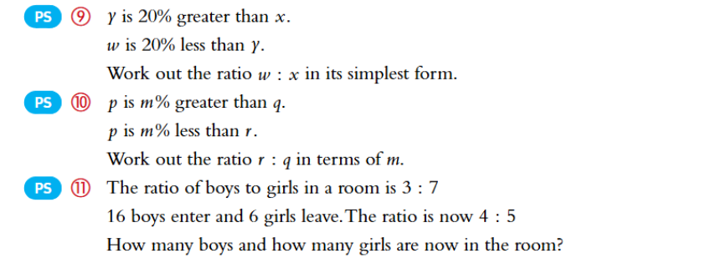
Exercises continued

