Slide 1
Week 2
Functions 1
AQA Further Maths GCSE

Slide 2
Objectives
To understand the definition of a function
To understand the domain and range of a function
To be able to sketch graphs of functions

Slide 3
Notes
To understand the definition of a function

Slide 4
Notes
To understand the domain and range of a function

Slide 5
Notes
To be able to sketch graphs of functions

Slide 6
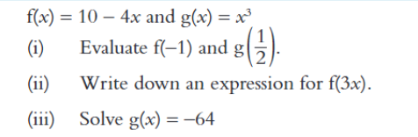
Example 1

Slide 7
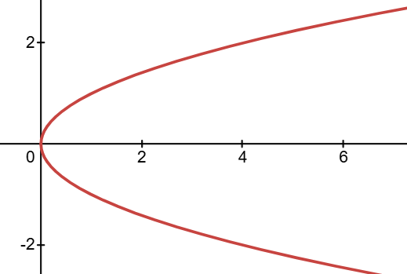
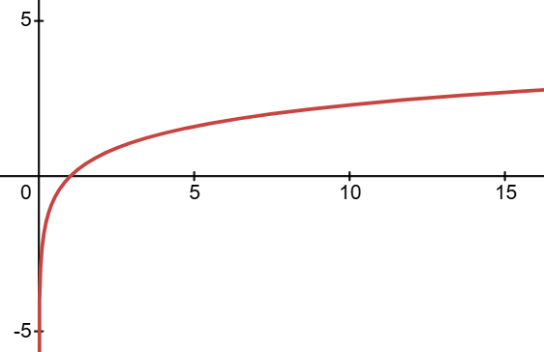
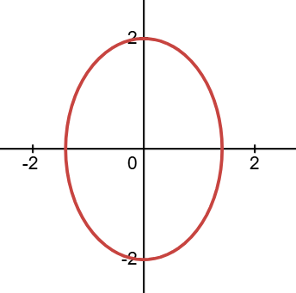
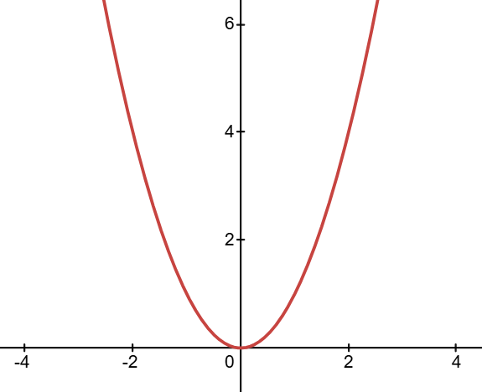
Example 2
Which of the following are functions?
a)
b)
c)
d)

Slide 8
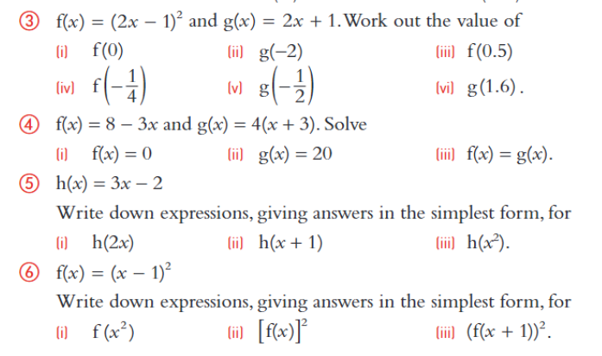
Exercises

Slide 9
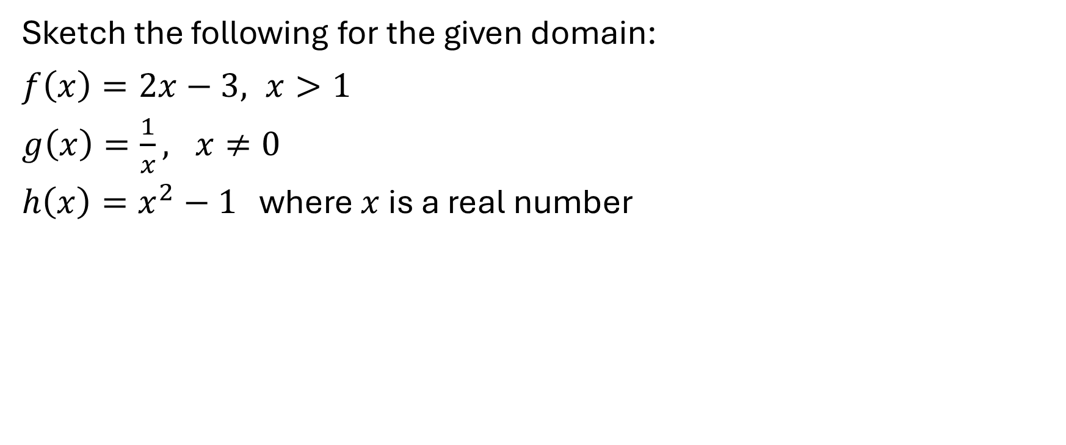
Example 3
Sketch the following for the given domain:
$f\left(x\right)=2x−3, x>1$
$g\left(x\right)=\frac{1}{x}, x≠0$
$h\left(x\right)=x^{2}−1$ where $x$ is a real number

Slide 10
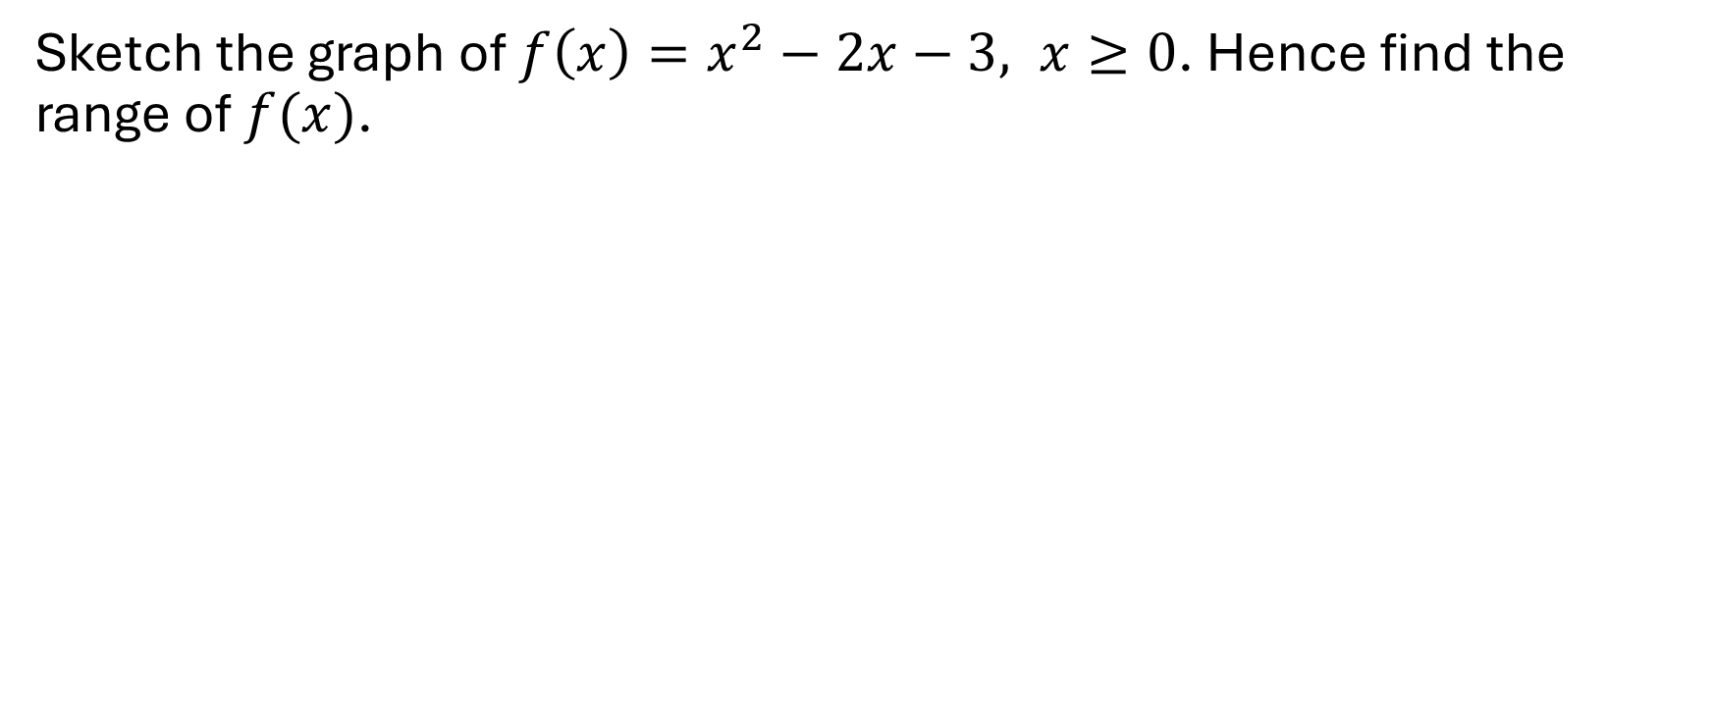
Example 4
Sketch the graph of $f\left(x\right)=x^{2}−2x−3, x≥0$. Hence find the range of $f(x)$.

Slide 11
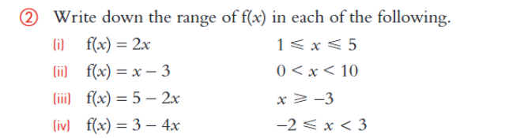
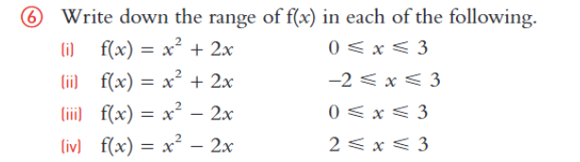
Exercises

Slide 12
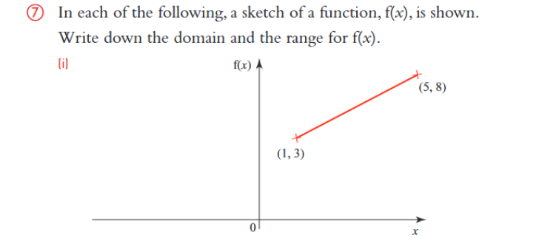
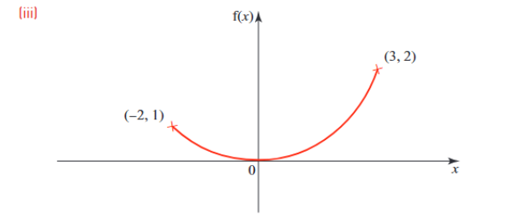
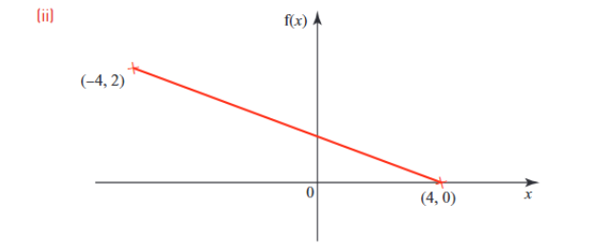
Exercises Continued

Slide 13
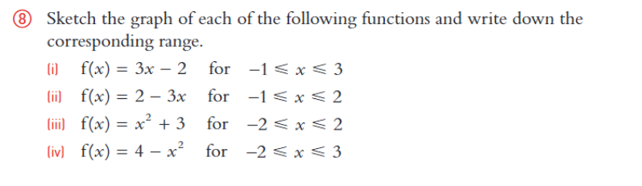
Exercises Continued

