Slide 1
Week 3
Functions 2
AQA Further Maths GCSE

Slide 2
Objectives
Understand and work with composite functions
To understand what an inverse function is, whether it exists, and how to find it if it does

Slide 3
Notes
Understand and work with composite functions

Slide 4
Notes
To understand what an inverse function is, whether it exists, and how to find it if it does

Slide 5
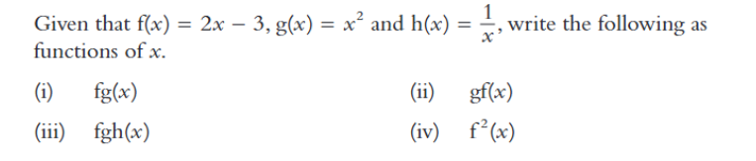
Example 1

Slide 6
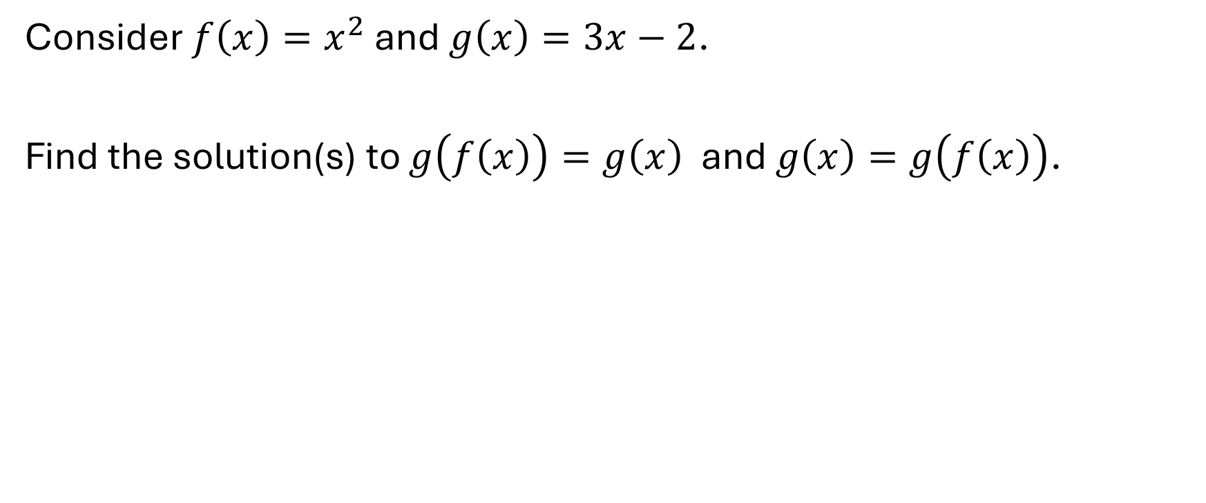
Example 2
Consider $f\left(x\right)=x^{2}$ and $g\left(x\right)=3x−2$.
Find the solution(s) to $g\left(f\left(x\right)\right)=g\left(x\right)$ and $g\left(x\right)=g\left(f\left(x\right)\right)$.

Slide 7
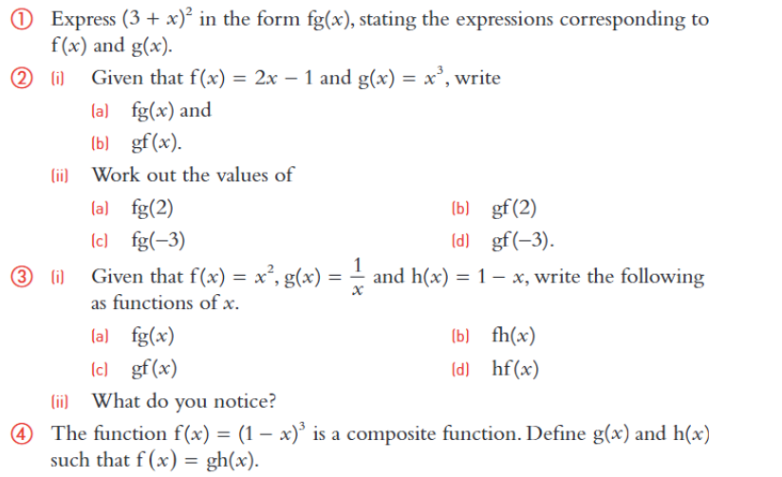
Exercises

Slide 8
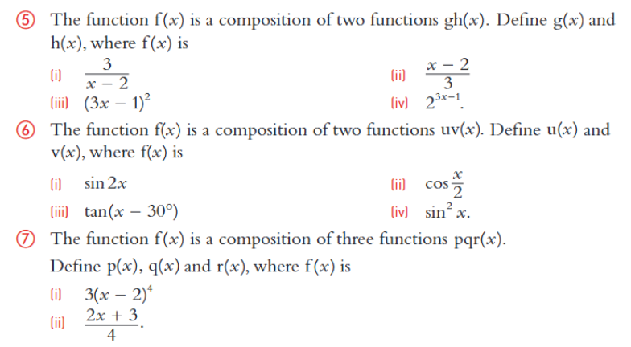
Exercises Continued

Slide 9
What do we mean by the inverse function?

Slide 10
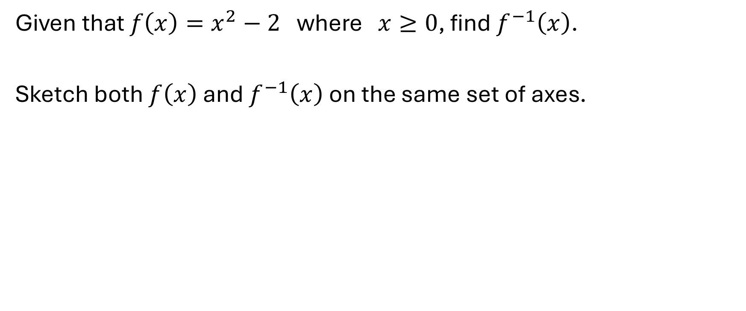
Example 3
Given that $f\left(x\right)=x^{2}−2$ where $x≥0$, find $f^{−1}\left(x\right)$.
Sketch both $f\left(x\right)$ and $f^{−1}\left(x\right)$ on the same set of axes.

Slide 11
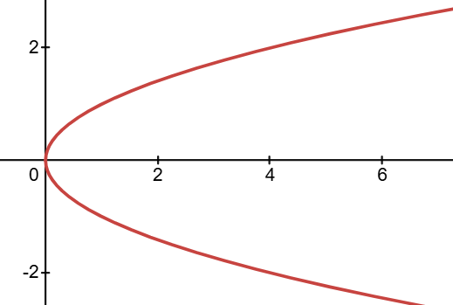
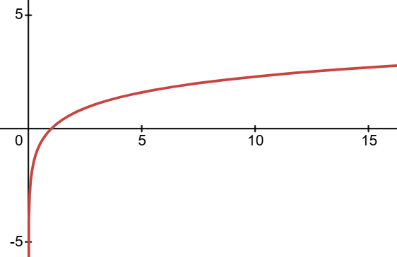
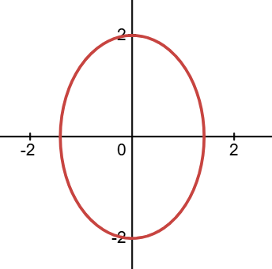
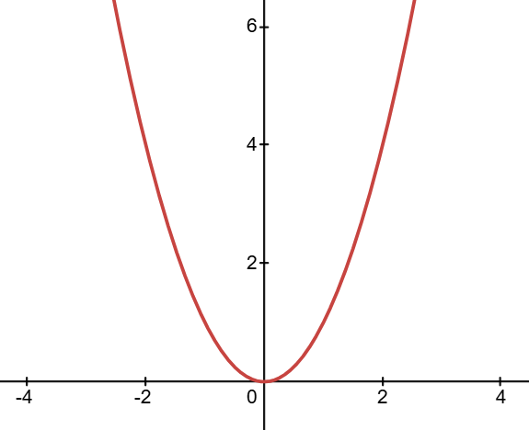
Example 4
For which of the following does the inverse function exist?
a)
b)
c)
d)

Slide 12
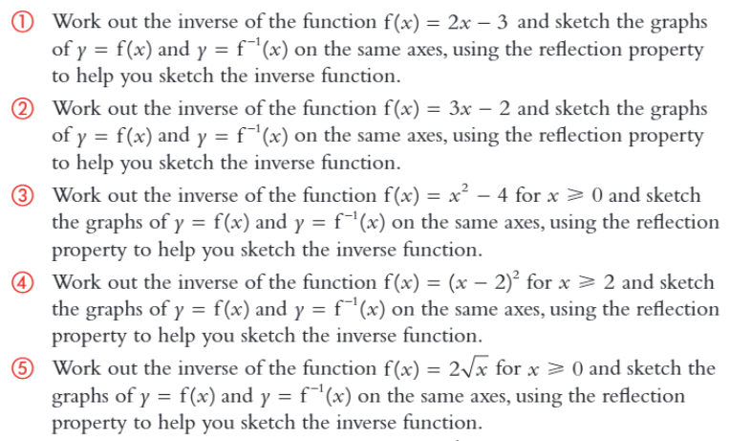
Exercises

Slide 13
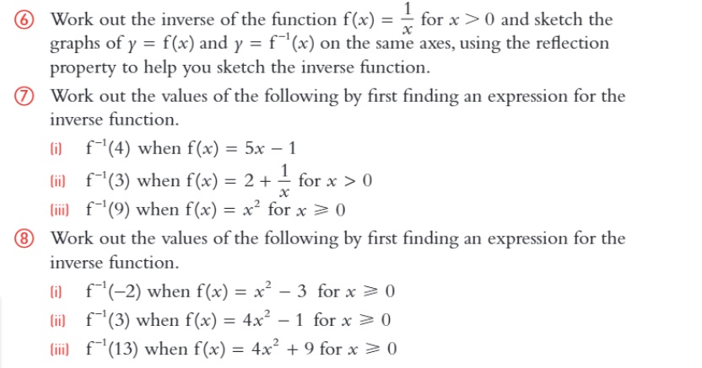
Exercises Continued

