Slide 1
Week 4
Binomial Expansion
AQA Further Maths GCSE

Slide 2
Objective
Expanding brackets
Using binomial expansion to multiply out brackets

Slide 3
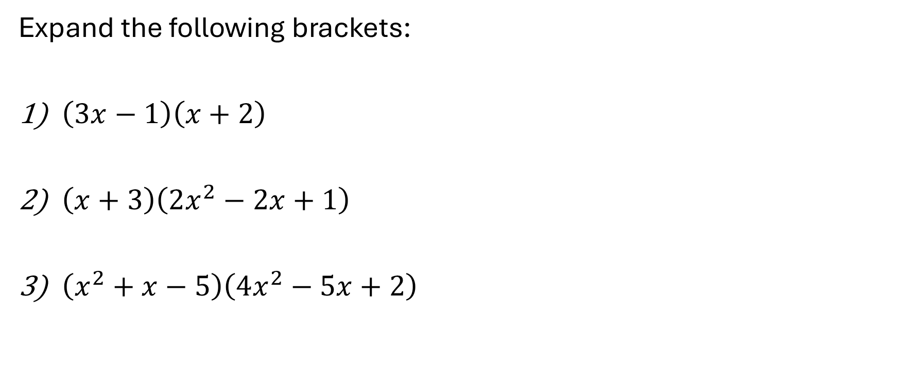
Example 1
Expand the following brackets:
$\left(3x−1\right)\left(x+2\right)$
$\left(x+3\right)\left(2x^{2}−2x+1\right)$
$\left(x^{2}+x−5\right)\left(4x^{2}−5x+2\right)$

Slide 4
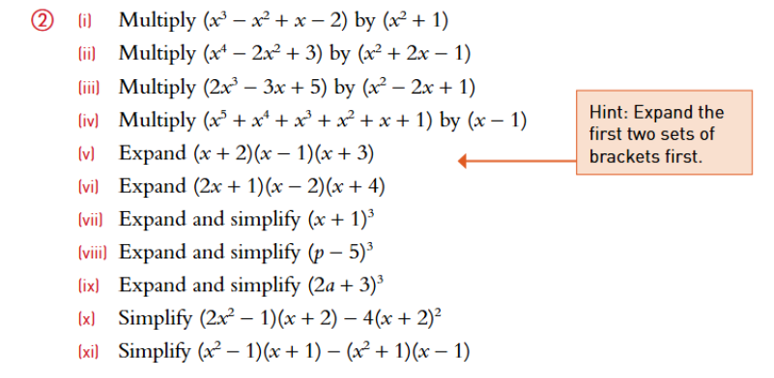
Exercises

Slide 5
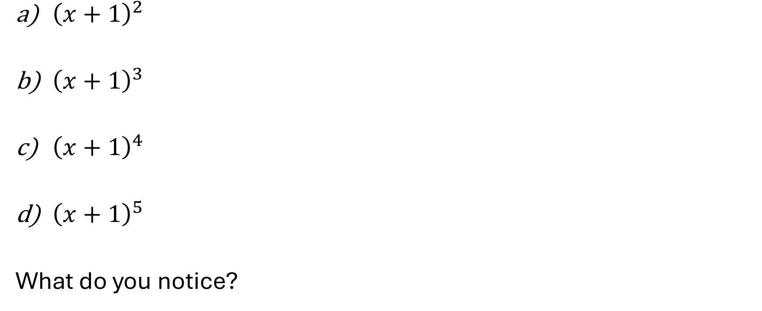
Example 2
${\left(x+1\right)}^{2}$
${\left(x+1\right)}^{3}$
${\left(x+1\right)}^{4}$
${\left(x+1\right)}^{5}$
What do you notice?

Slide 6
Pascal’s Triangle

Slide 7
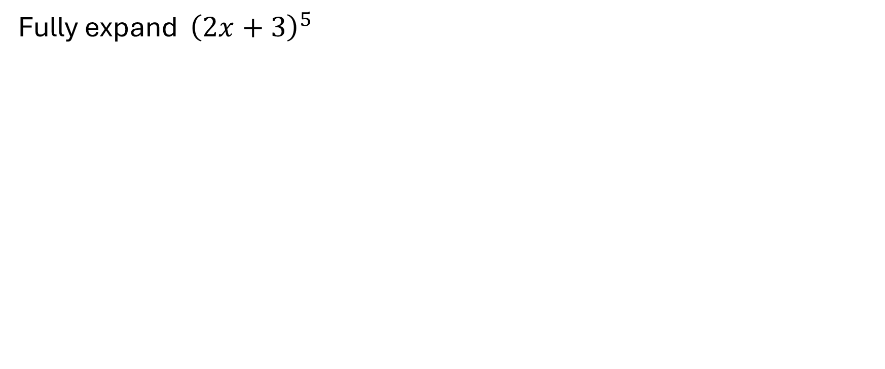
Example 3
Fully expand ${\left(2x+3\right)}^{5}$

Slide 8
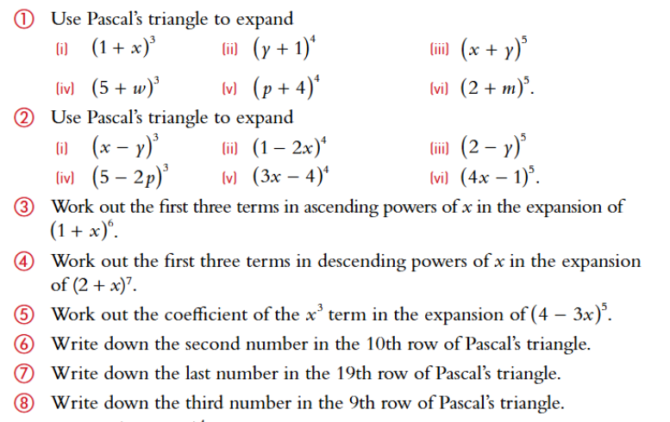
Exercises

Slide 9
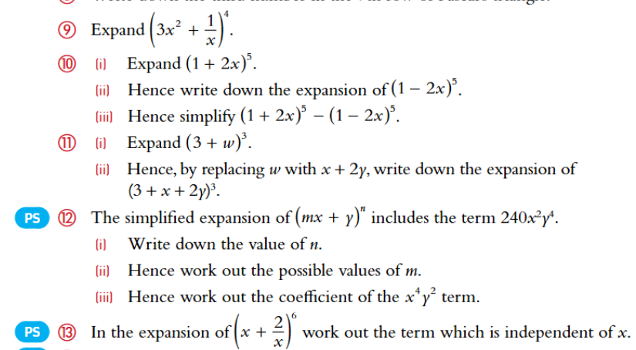
Exercises continued…

