Slide 1
Week 5
Factorising (with a bit of Binomial too…)
AQA Further Maths GCSE

Slide 2
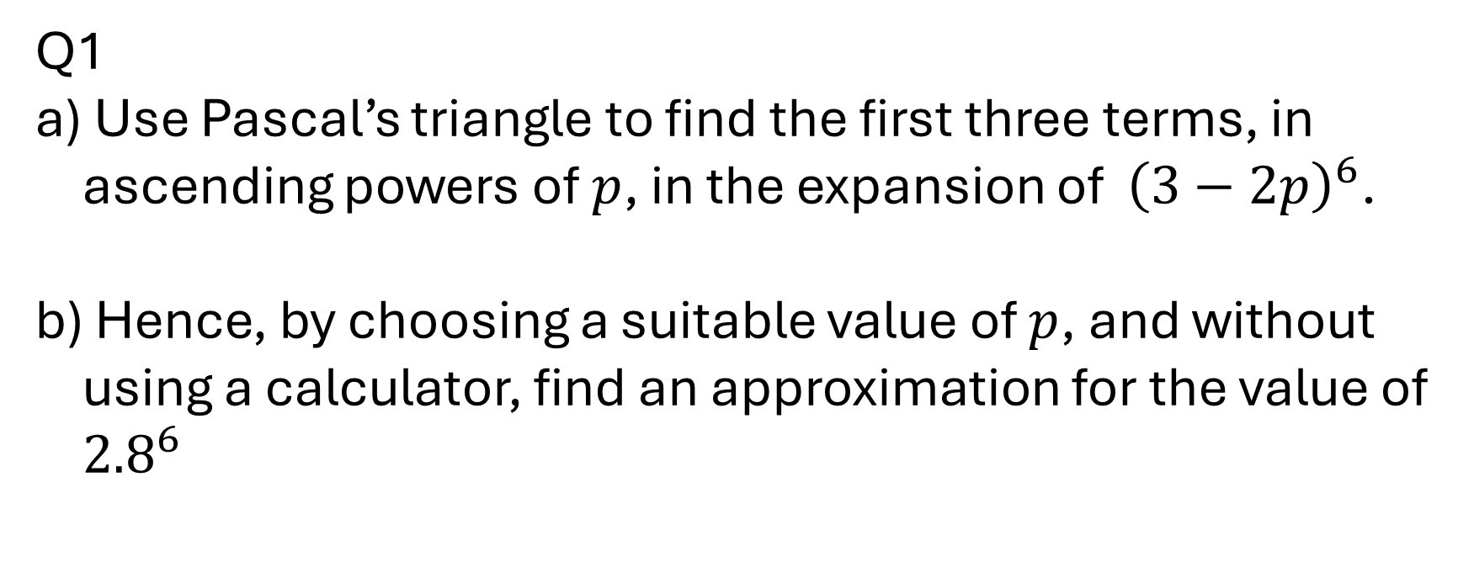
Starter – can you remember last week?
Q1
Use Pascal’s triangle to find the first three terms, in ascending powers of $p$, in the expansion of ${\left(3−2p\right)}^{6}$.
Hence, by choosing a suitable value of $p$, and without using a calculator, find an approximation for the value of ${2.8}^{6}$

Slide 3
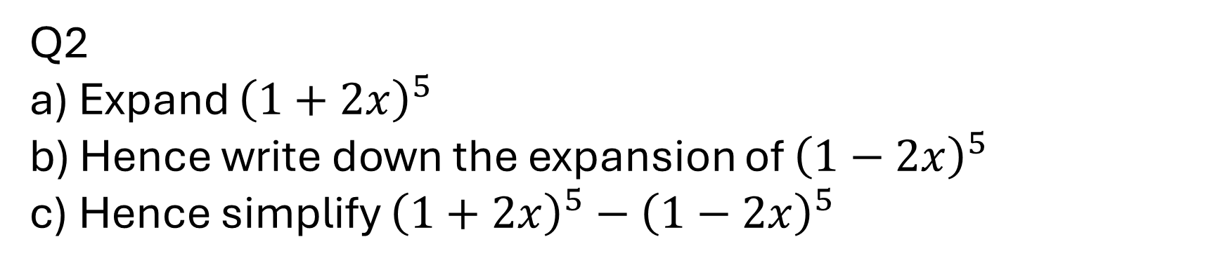
Starter – can you remember last week?
Q2
Expand ${\left(1+2x\right)}^{5}$
Hence write down the expansion of ${\left(1−2x\right)}^{5}$
Hence simplify ${\left(1+2x\right)}^{5}−{\left(1−2x\right)}^{5}$

Slide 4
Objective
Factorising quadratic expressions
Completing the square
Manipulating formulae
Simplifying rational expressions

Slide 5
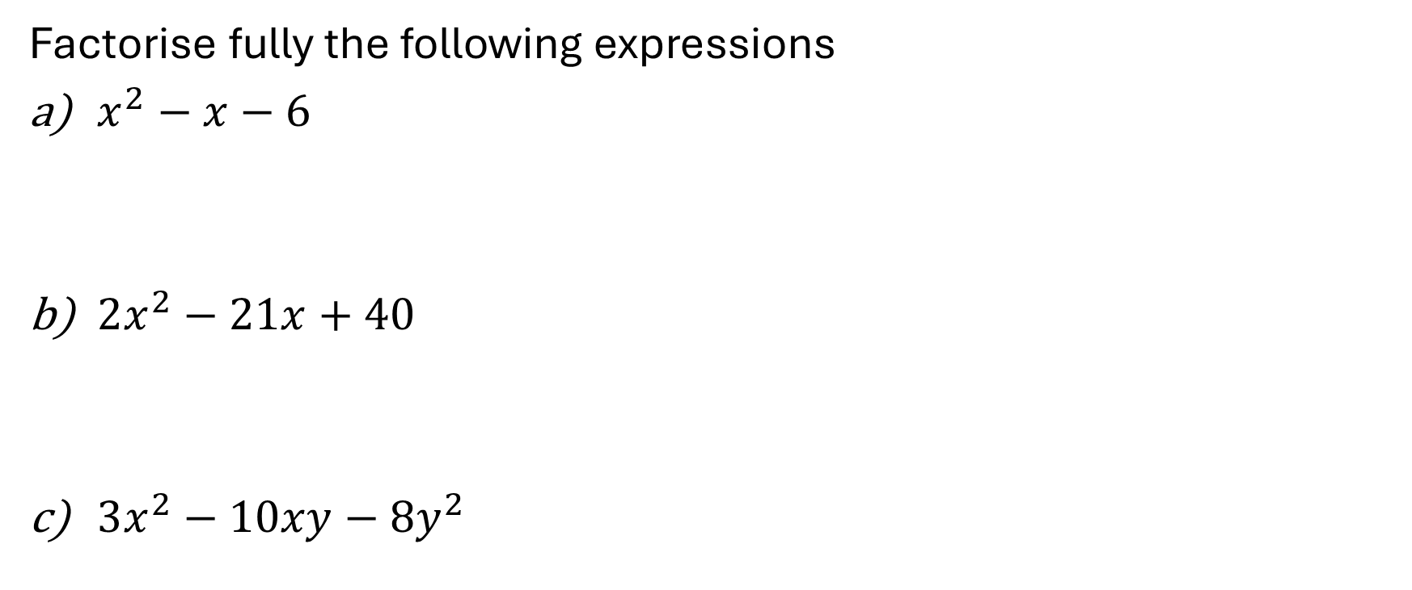
Example 1
Factorise fully the following expressions
$x^{2}−x−6$
$2x^{2}−21x+40$
$3x^{2}−10xy−8y^{2}$
Why is factorising quadratic expressions a useful thing to be able to do?

Slide 6
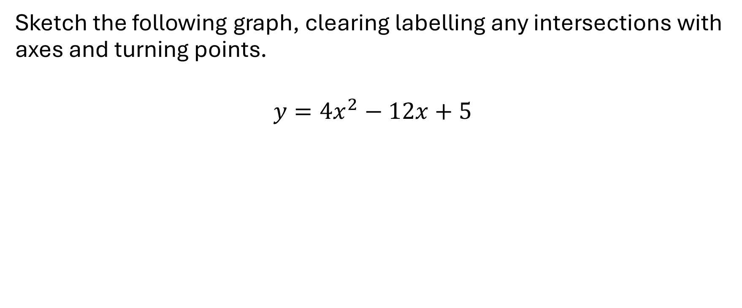
Example 2
Sketch the following graph, clearing labelling any intersections with axes and turning points.
$$y=4x^{2}−12x+5$$

Slide 7
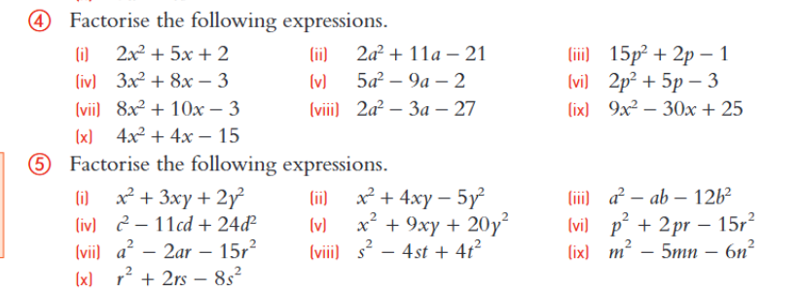
Exercises

Slide 8
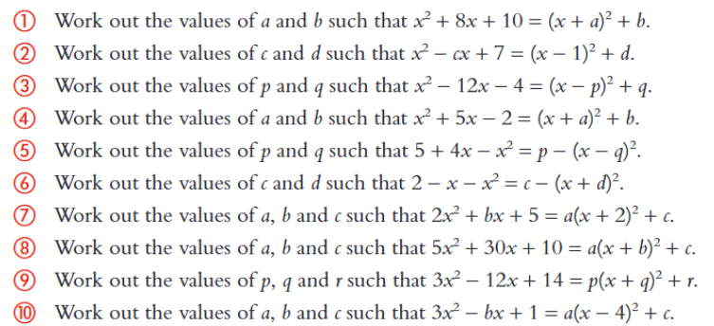
Exercises continued

Slide 9

Example 3
Make $x$ the subject of this formula:
$$y=\frac{x+2}{1+3x}$$

Slide 10
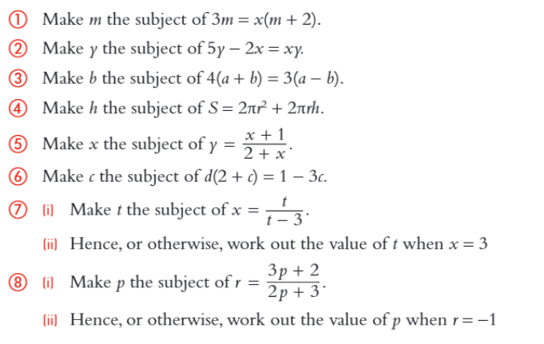
Exercises

Slide 11
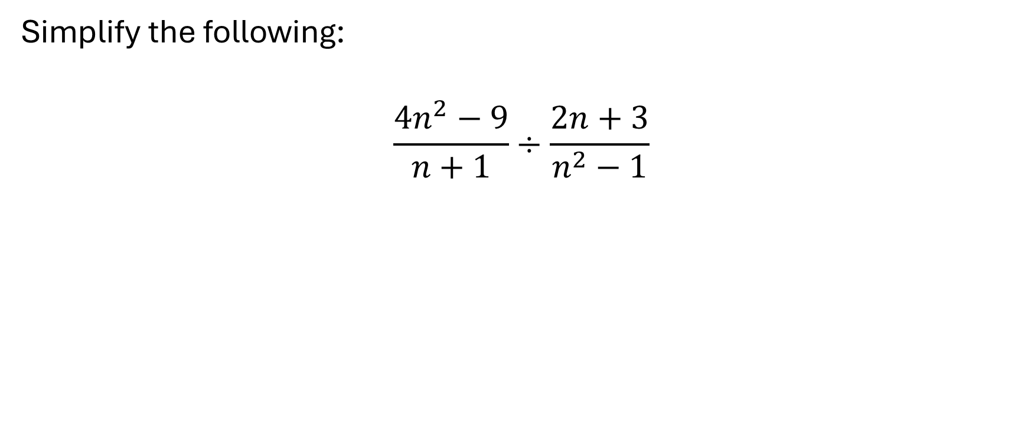
Example 4
Simplify the following:
$$\frac{4n^{2}−9}{n+1}÷\frac{2n+3}{n^{2}−1}$$

Slide 12
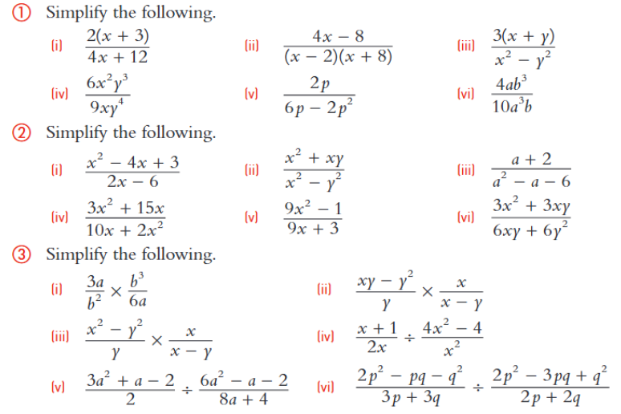
Exercises

Slide 13
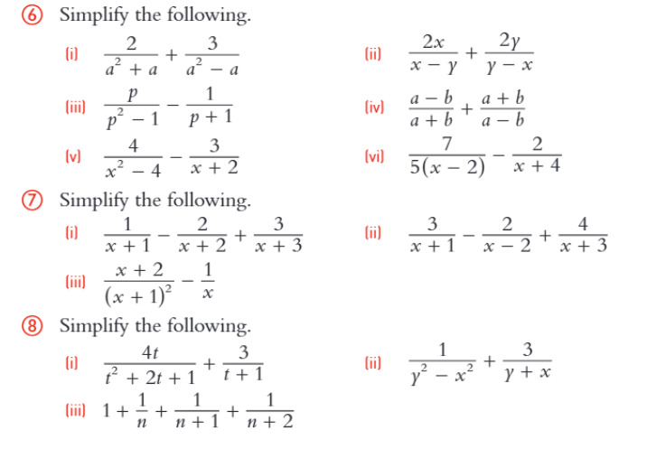
Exercises continued

