Slide 1
Week 6
Factor Theorem
AQA Further Maths GCSE

Slide 2
Objectives
Understand the factor theorem
Use the factor theorem to factorise cubic equations
Understand how to factorise cubic equations using polynomial long division and by inspection

Slide 3
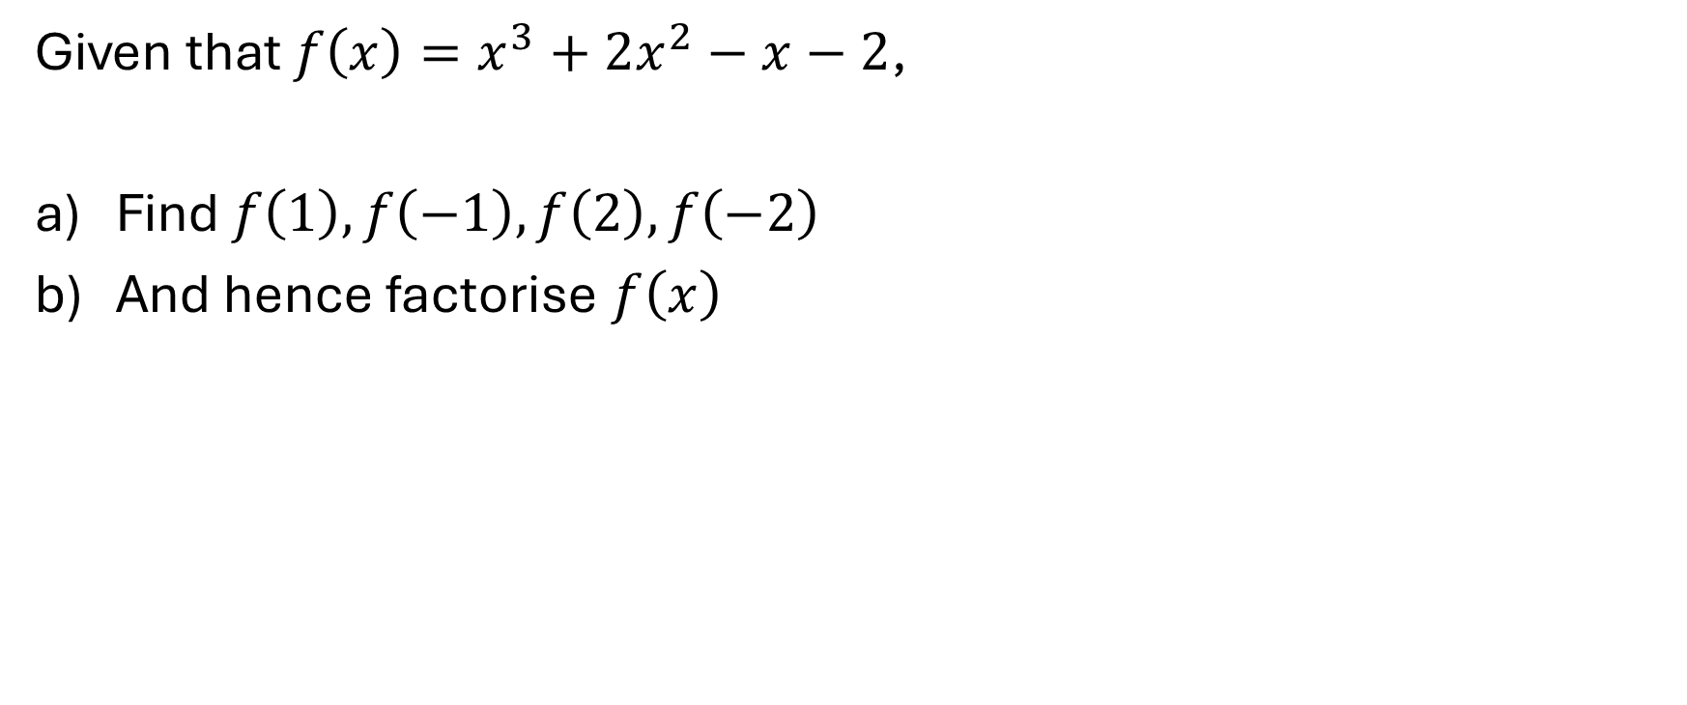
Example 1
Given that $f\left(x\right)=x^{3}+2x^{2}−x−2$,
Find $f\left(1\right), f\left(−1\right), f\left(2\right), f\left(−2\right)$
And hence factorise $f\left(x\right)$

Slide 4
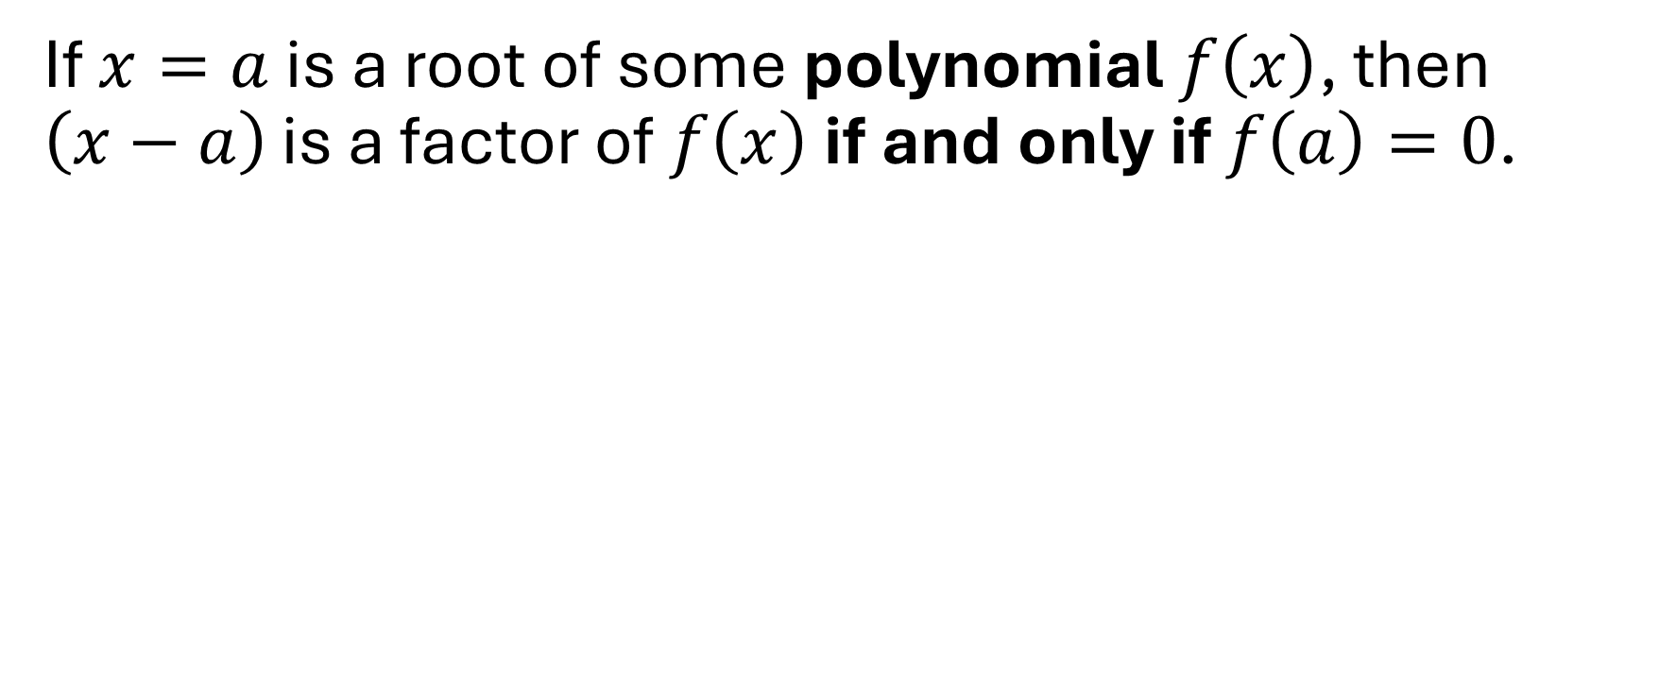
The factor theorem
If $x=a$ is a root of some polynomial $f\left(x\right)$, then $\left(x−a\right)$ is a factor of $f\left(x\right)$ if and only if $f\left(a\right)=0$.

Slide 5
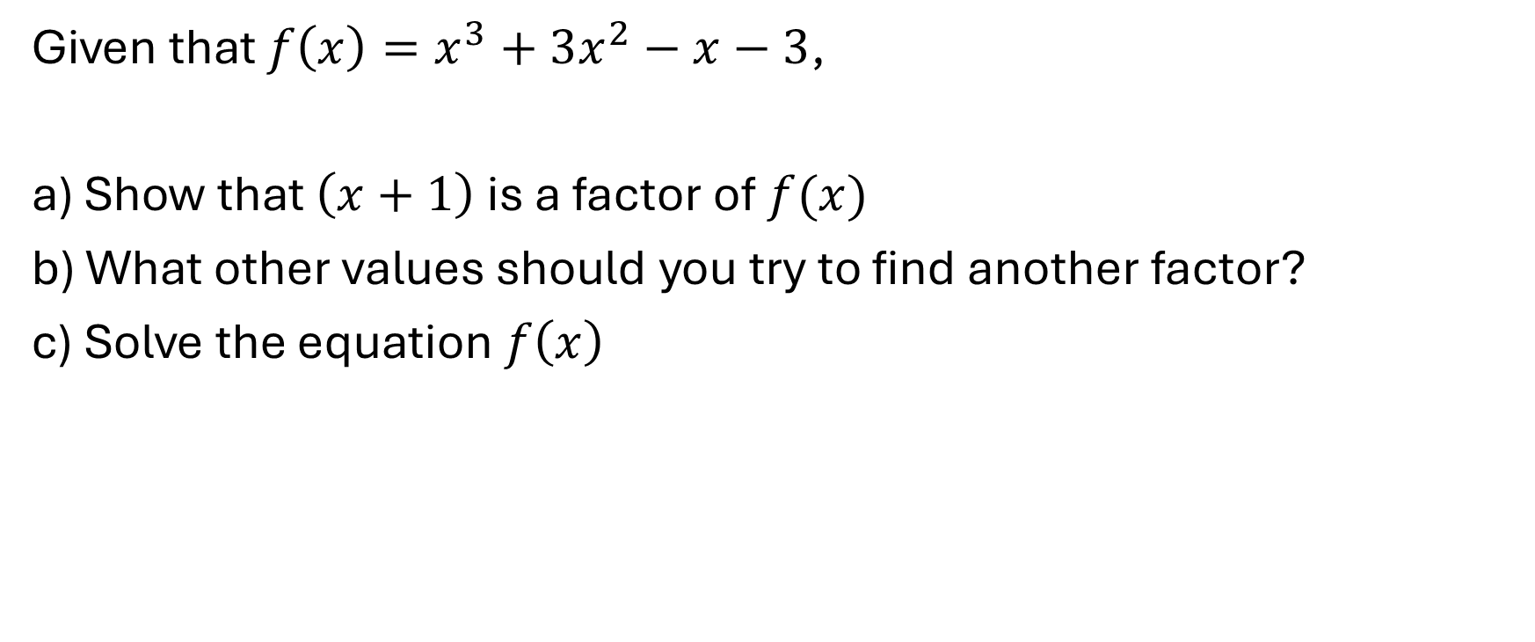
Example 2
Given that $f\left(x\right)=x^{3}+3x^{2}−x−3$,
a) Show that $\left(x+1\right)$ is a factor of $f(x)$
b) What other values should you try to find another factor?
c) Solve the equation $f\left(x\right)$

Slide 6
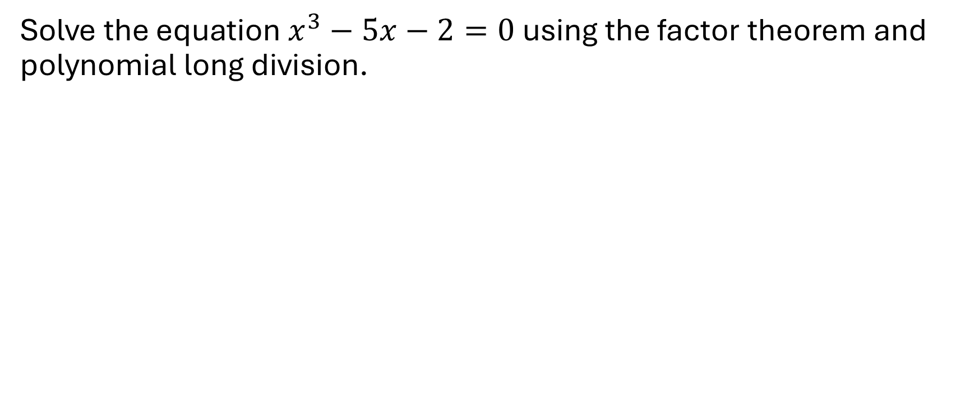
Example 3
Solve the equation $x^{3}−5x−2=0$ using the factor theorem and polynomial long division.

Slide 7
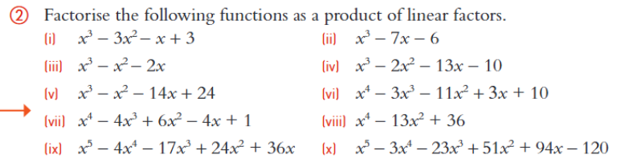
Exercises

Slide 8
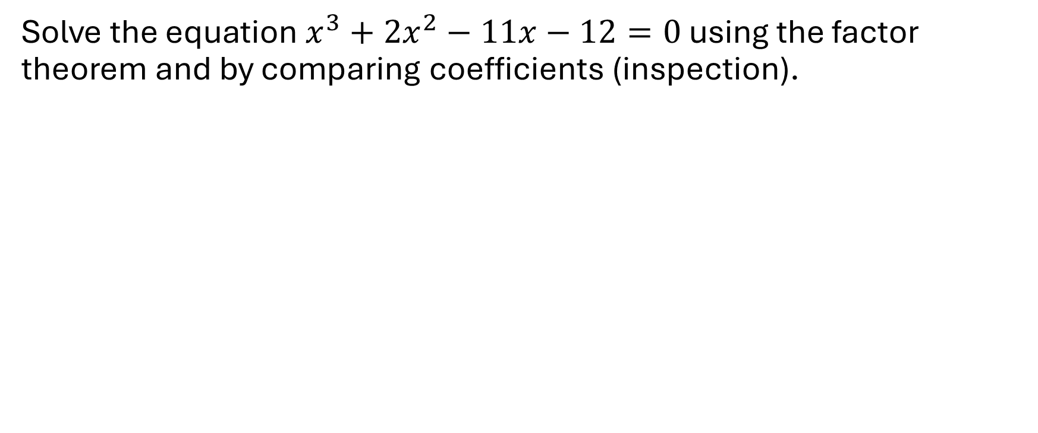
Example 4
Solve the equation $x^{3}+2x^{2}−11x−12=0$ using the factor theorem and by comparing coefficients (inspection).

Slide 9
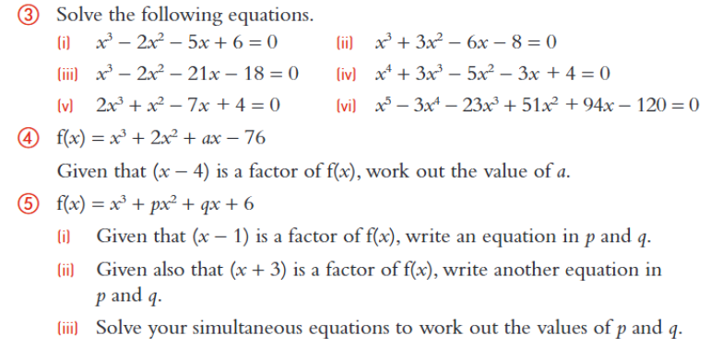
Exercises

Slide 10
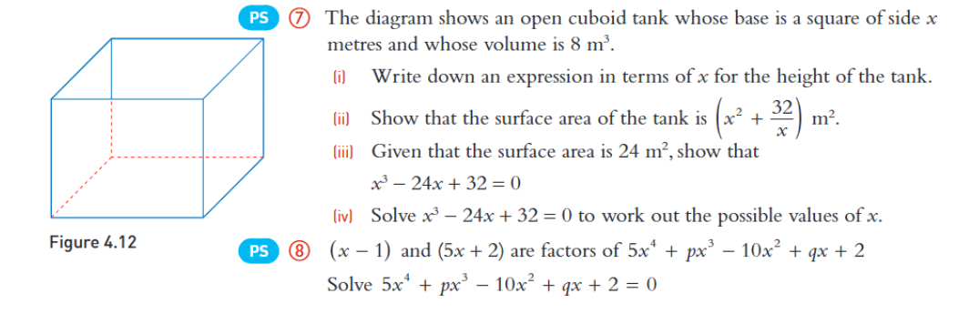
Exercises continued

